Slide 1
Hosting a Wellness Day

Slide 2
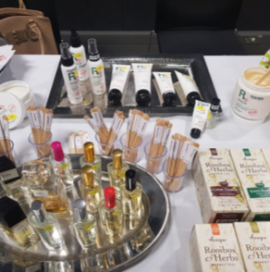
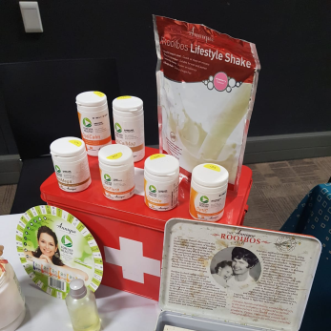
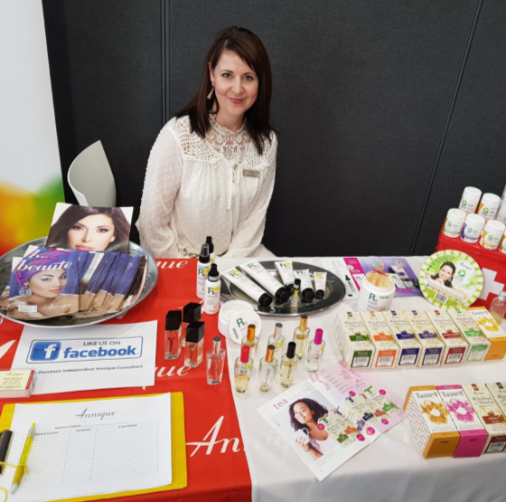
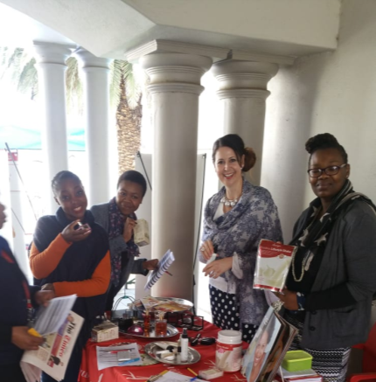

Slide 3
Imagine this …

Slide 4
Dear Penny
HOW WOULD YOU LIKE TO TAKE BACK YOUR HEALTH?
Complete the following quick Annique Health Assessment and send your answers back to me so that I can recommend from our
Forever Healthy Range, products best suited for you.
REMEMBER
Winter is here and so is Covid-19!
It is extra important to give your IMMUNE SYSTEM some needed boosts;
If you are not on a medical aid, this would be the perfect start for you!

Slide 5
Which of these health factors, A, B, C or D are you concerned about, if not all?
A
Gut health and toxin removal
Toxic overload
Migraine and headaches
Drink unfiltered water
Diarrhoea
Heavy metal toxicity
Cancer
B
Mood, memory, heart and brain health
High blood lipids – cholesterol
High blood pressure
Mood swings or depression
Poor memory – ADD, ADHD
Irregular or rapid heartbeat
Dry skin | eczema | psoriasis
C
Acid reflux, high or low blood pressure
Hyperacidity
Heartburn | acid reflux
High or low blood pressure
Gout | arthritis
Gall stones | kidney stones
Muscle cramps
D
Family history of cancer and allergies
Family history of diabetes
Family history of heart disease
Family history of cancer
Signs of premature aging
Difficulty getting rid of infections
Allergies
Please send your answer back to me so that I can recommend accordingly

Slide 6
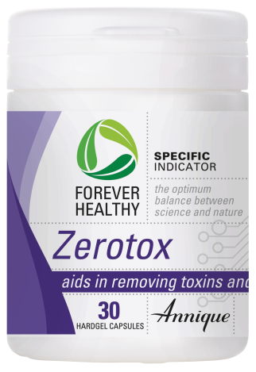
A
Gut health & toxin removal
Why use it?
Clears out heavy metals and toxins
Brings relief for indigestion and IBS
Clears the liver to help control your appetite
Chemo patients
ONLY R339!
AE/08244/18

Slide 7
B
Mood, memory, heart and brain health
Why use it?
Benefits childhood learning
Supports 2 critical organs, your heart and brain
Fights autoimmune diseases
Prevents dermatitis and dry skin
ONLY R169!
SAVE R60!
AE/08252/19

Slide 8
C
Acid reflux, high or low blood pressure
Why use it?
Makes the body slightly alkaline
Restore mineral balance
Prevents illness, disease and ageing
Removes waste products
ONLY R239!
SAVE R130!
AE/08229/12

Slide 9
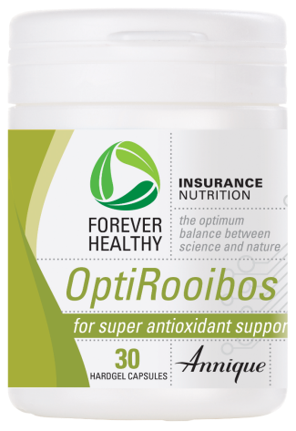
D
Family history of cancer and allergies
Why use it?
Fights bacterial and viral infections
Antioxidants promotes anti-ageing
Prevents inflammation
Aids in relieving allergies
ONLY R269!
AE/08242/17

Slide 10
Tips

Slide 11
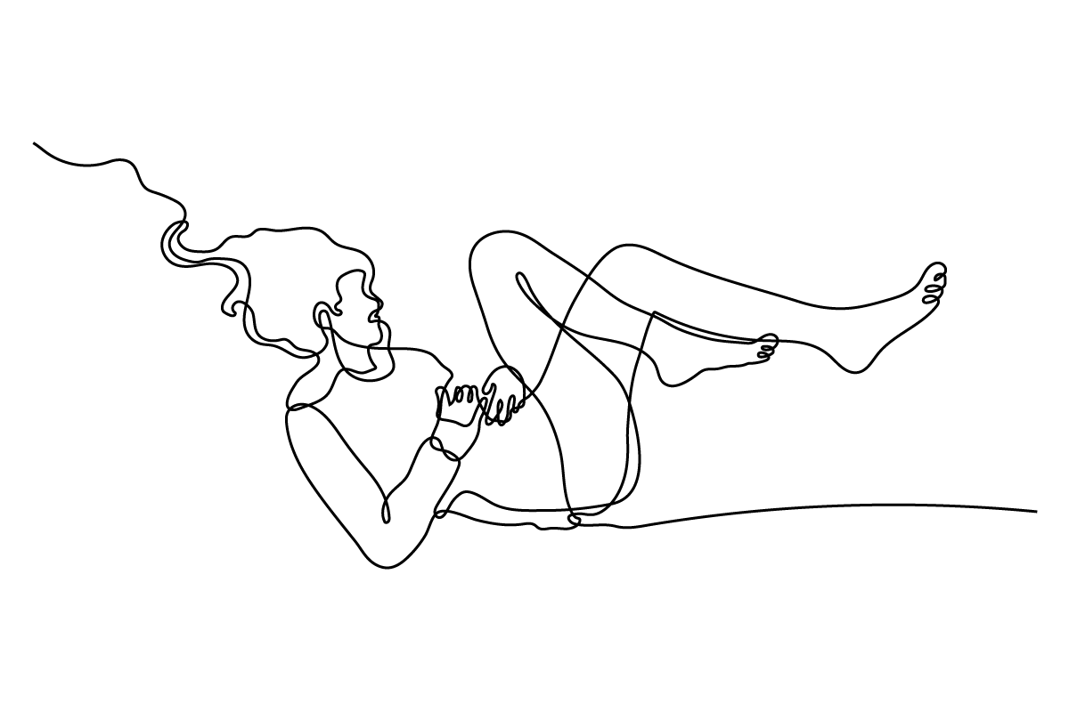
You are invited!
Join us on zoom for an
Annique Wellness Event
Without good health we won't be living long and happy lives.
Take control over your wellness the unique Annique way and let your health become
your wealth.
BOOK
NOW!
To receive Meeting ID
06 June 2020 at 09.00

Slide 12
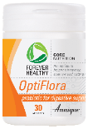
How would you like to be contacted?
THANK YOU VOUCHER
MAKE AN
Phone Call
Email
Whats App
Whats App Video
Zoom
Messenger
۝
۝
۝
۝
۝
۝
appointment
FOR A
FREE
Health
BOOK
NOW!
Care
Analysis!

