Slide 1
Forever Heathy
Superfood Supplements

Slide 2
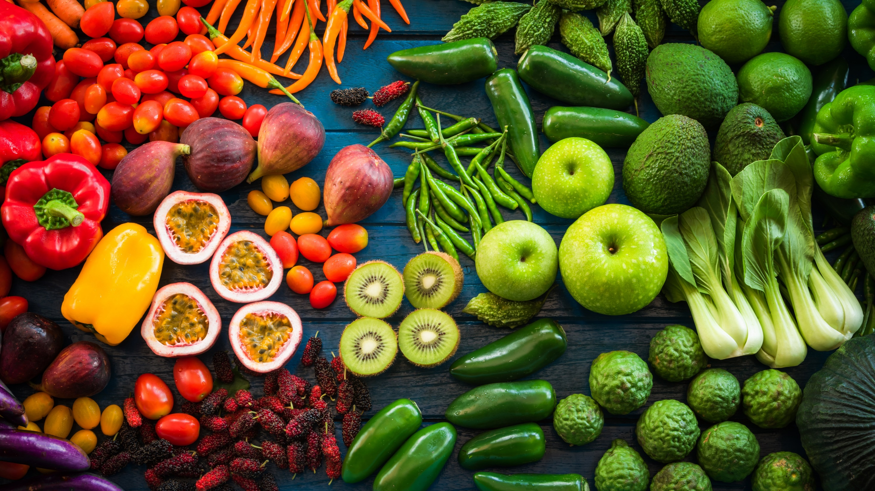
Superfoods
Helps prevent disease
Packed with nutrients
Antioxidants: fight disease causing free radicals
Notes:
Did you know Rooibos is a superfood? Time Magazine names Rooibos as one of the top 50 superfoods in the world! Rooibos is indigenous to South Africa and has now been awarded Protected Designation of Origin status from the European Union. Other products that also have this status include Champagne, Port and Parma ham. Rooibos is the first African food to be awarded this status and it means that Rooibos is protected and appreciated for its uniqueness.
All our Superfood supplements contain Rooibos for its anti-ageing, antioxidant and amazing health promoting benefits including that is fights heart disease, diabetes, cancer and stress.
Let’s pause for a moment and talk about antioxidants. We hear this term often and we know they are good for us, but people seldom know what they are and what they do. In simple terms, antioxidants are molecules that fight free radicals in our bodies. Now what on earth are free radicals? Free radicals are compounds that can cause harm if their levels become too high. This leads to many diseases including heart disease, cancer, diabetes, etc.
The balance between antioxidants and free radicals is critical. When free radicals exceed antioxidants, this is called oxidative stress and being in this state for too long leads to DNA damage and even cell death.
Think of it like this: every cell in your body is made up of millions of molecules that communicate and mingle with each other, and each molecule is made up of electrons. When a molecule loses an electron, the molecule is unbalanced and becomes a free radical trying to steal electrons from other modules to restore itself. Imagine that each molecule is a sports team made up of a certain amount of electron players. During the game, one of the players can be injured or sent off the field resulting in an unbalanced team. An unbalanced team becomes a free radical, obsessed by replacing that player, sometimes even trying to steal another player, creating chaos on the field. Antioxidants are like the reserve team and they will gladly donate one of their players to the free-radical team to restore balance.
Now, as you know, we at Annique are passionate about making a difference in people’s lives. And improving someone’s health is the ideal way to do this.
To this end, Annique has made it easy and convenient to get the best of what nature has to offer in the form of Superfood Supplements!
We must also understand that we don’t need to have ailments to take superfoods. Much of the benefits of these supplements are for preventative care. Good health doesn’t magically happen after eating one healthy meal or one stint in the gym. It something that we need to constantly work at and invest in, and taking supplements to prevent disease later in life is part of this approach. And this is where Superfood Supplements shine.
Annique’s Superfood Strategy
The idea behind the strategy is to have a “Rainbow” of superfood supplements, each Superfood has its own benefit.
What are superfoods?
Superfoods are exactly what their names suggest. They are super hero’s from our food sources. They are given the label of super, because they offer maximum nutritional benefits that our bodies require. They also contain large amounts of minerals, vitamins and antioxidants. Antioxidants are especially important to our bodies, because they neutralize free radicals that can cause ageing and disease.

Slide 3
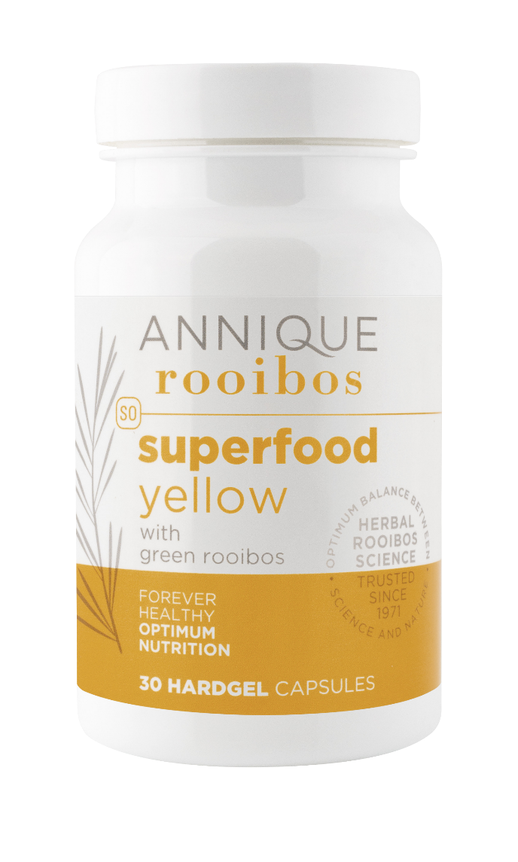
Superfood Yellow
UNIQUE BENEFITS
Powerful antioxidants from curcumin, ginger and Green Rooibos
Natural
anti-inflammatory
RECOMMENDED FOR:
Inflammatory conditions, like arthritis
Nausea
Overall skin health
Eye health
Notes:
Superfood Yellow
UNIQUE BENEFITS
Anti-inflammatory
Potent antioxidants
Promotes eye health
Soothes arthritis
Promotes healthy joints
Promotes healthy skin
Promotes digestion
Direction for Use
Adults: Take 1 capsule per day or as recommended by your healthcare practitioner
Children: Over the age of 12 years – Take one a day
Time of day: PM

Slide 4
Superfood Yellow
PRODUCT STORY
Natural fire-fighter that extinguishes burning inflammation
Notes:
Chronic inflammation has been identified as the root cause of all diseases.
A silent killer - like a rampant smoldering wild fire in your body you can’t see nor feel.
Superfood yellow is like the firefighter that helps to put out the fire

Slide 5
Superfood Yellow
HOW TO USE IT
Adults: Take 1 capsule per day or as recommended by your healthcare practitioner
Children: Over the age of 12 years – Take one a day
Time of day: PM
Natural
anti-inflammatory

Slide 6
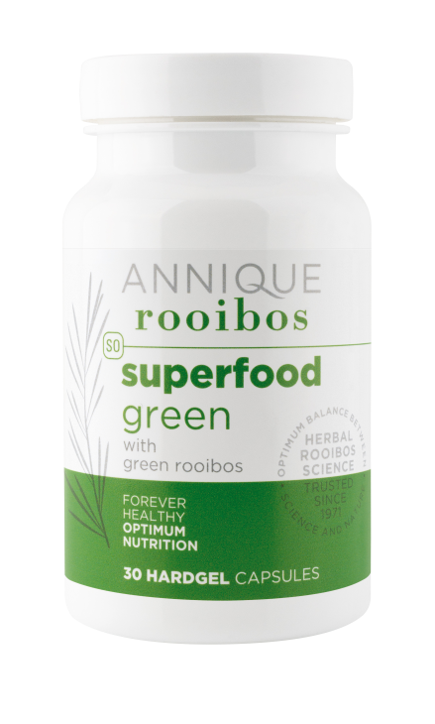
Superfood Green
UNIQUE BENEFITS
A plant-based blend of 7 mostly green vegetables
Ideal for people who don’t eat enough greens
May help reduce “bad” LDL levels
Helps with arterial health
May help for weightloss
Increases energy
Naturally Lowers Cholesterol

Slide 7
Superfood Green
PRODUCT STORY
Personal body guard against
bad cholesterol
Notes:
Superfood green is a blend of 7 Mostly green vegetables.
Rich in antioxidants
Helps keep the “bad” Cholesterol at bay
Antioxidants are like your cells’ personal body guard, that help to neutralise the harmful free radicals that might harm them.
SF Green helps keep “bad” cholesterol at bay
They keep law and order in your body

Slide 8
Superfood Green
HOW TO USE IT
Naturally Lowers Cholesterol
Adults: Suitable for people aged 18 years and older
Time of day: 1x capsule – AM
Not suitable for children

